Slide 1
This – that these – those
Use of demonstrative pronouns

Slide 2
→ this and that : singular items → these and those: plural items.
Singular:
This is…. (near)
That is …….. (far)
Negative:
This is not… or This isn’t…
That is not… or That isn’t…
Plural:
These are…. (near)
Those are ……….. (far)
Negative:
These are not… or these aren’t…
Those are not… or those aren’t…

Slide 3
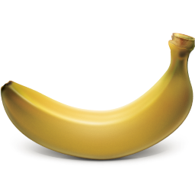




With singular items we use: this… that…
Singular ítems:
A banana →
→ A doll
An umbrela -------------------------→
←-------------------------------- A star
An animal -----------------------------→
This is a banana
This is a doll
That is an umbrela
That is a star
That’s an animal

Slide 4
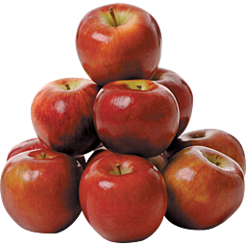
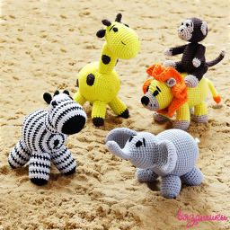



With plural items we use: these… those…
Plural ítems:
Apples →
→ Toys
Color pencils ----------------------------→
←------------------------------- Books
Students -------------------------------→
These are red apples.
These are toys.
Those are color pencils.
Those are books.
Those are students.

Slide 5



We also use the demostrative pronouns with people:
This is me. My name’s Ben. (in the center)
And this is my family.
This is my sister and that is her husband. And that’s their little baby. (on the right)
This is my wife and that is our daughter Susy. (on the left)

Slide 6

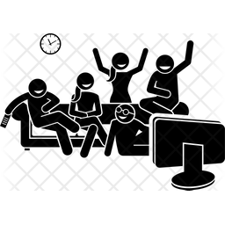

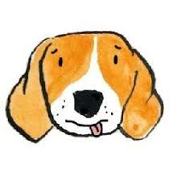
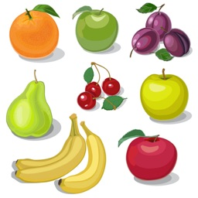


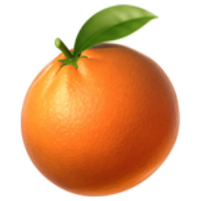
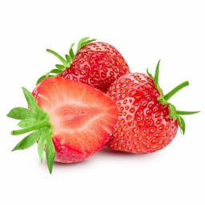
Let’s Practice:
Complete the sentences in singular:
Use this or that:
1.________ is a cat.
2.________ is a dog ………………..…..
3.________ is an iguana. ………….…
4.________ is an orange.
Complete the sentences in plural:
Use these or those:
1._________ are friends. ………….
2._________ are fruits.
3. _________ are papers.
……………..
4. _________ are strawberries.

Slide 7
questions and answers
Are these your fruits?
Yes, those are my fruits.
No, those aren’t my fruits.
Yes, they’re my fruits.
No, they aren’t.
Are those your friends?
Yes, these are my friends.
No, those aren’t my Friends.
Yes, they are.
-No, they aren’t.
………………………………………
Is that your dog?
………………………
Yes, that is my dog.
No, that’s not my dog.
Yes, it is my dog.
No, it’s not my dog.
Is this your cat?
Yes, it’s my cat.
No, it’s not my cat.

Slide 8
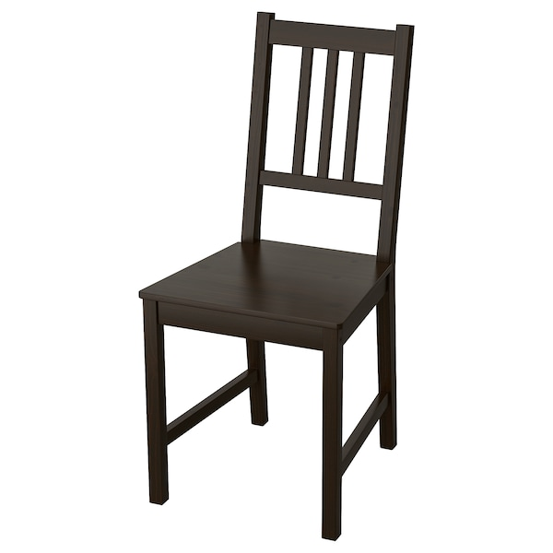
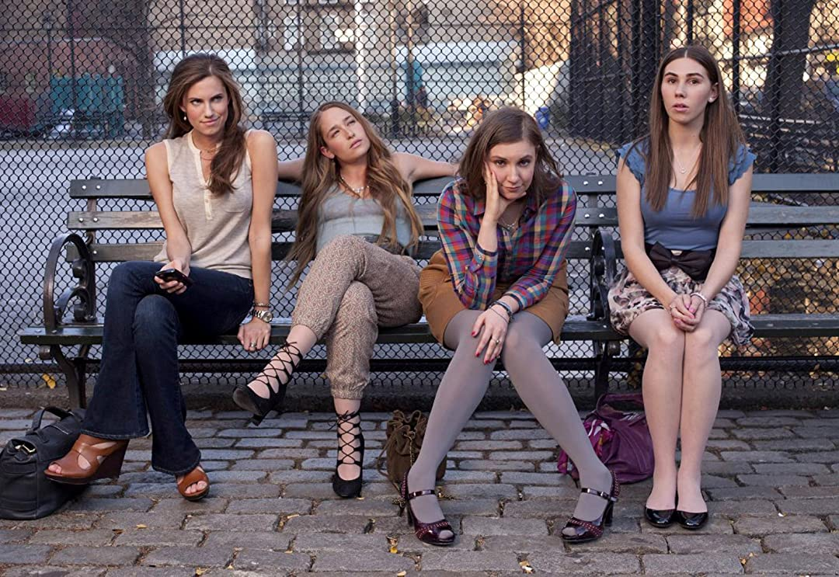
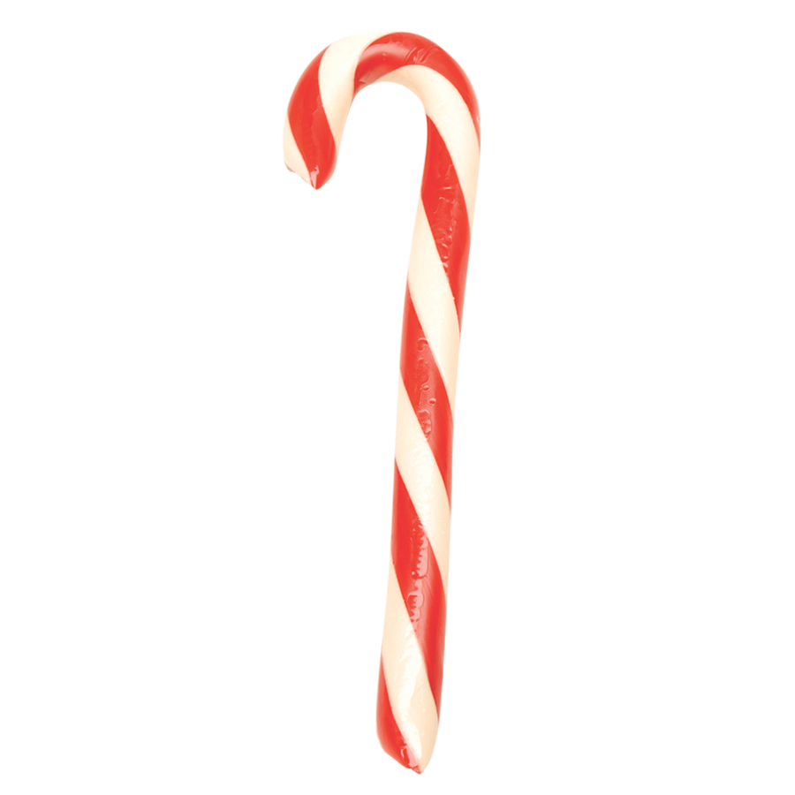
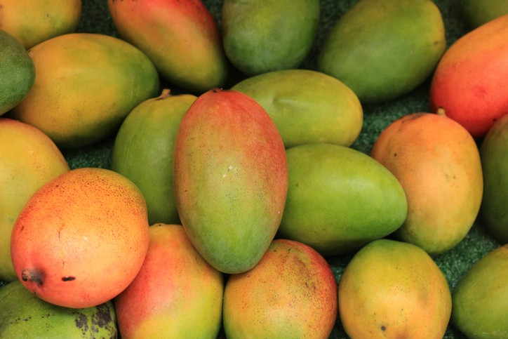
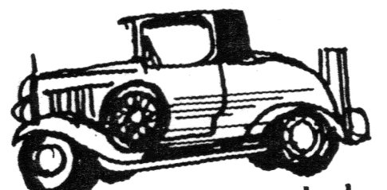
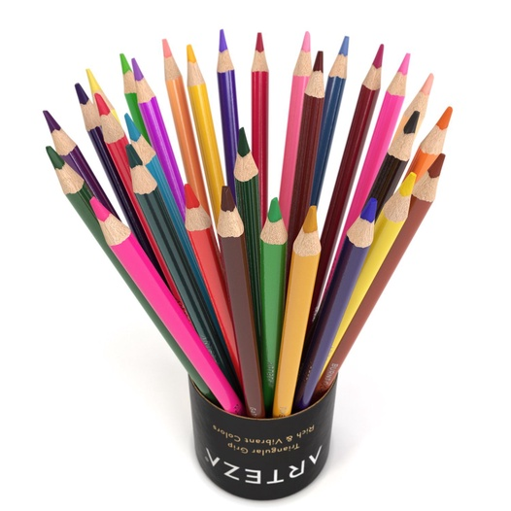
Practice: answer the questions.
Yes, it is.
Is that a chair?
Is this an umbrella?
Are those boys?
Are those mangoes?
Is this an orange?
Is that a car?
Are these toys?
No, it isn’t.
No, they aren’t.
Yes, it is.
Yes, they are.
Yes, it is.
No, they aren’t.

Slide 9
Keep on practicing! ☺

